Slide 1

FMEA Lecture 9 Dr. Stephen Daly

Slide 2

Control Overview
Purpose of Control Phase
To complete project work and hand off improved process to process owner, with approved procedures for maintaining the gains.

Slide 3
Deliverables of the Control Phase
Documented plan to transition improved process back to process owner, participants and sponsor.
Before and after data on process metrics
Operational, training, feedback, and control documents (updated process maps and instructions, control charts and plans, training documentation, visual process controls)
A system for monitoring the implemented solution (Process Control Plan), along with specific metrics to be used for regular process auditing.
Completed project documentation, including lessons learned, and recommendations for further actions or opportunities.

Slide 4
Key Steps of the Control Phase
Develop supporting methods and documentation to sustain full-scale implementation.
Launch Implementation
Lock in performance gains. Use mistake proofing or other measuresto prevent people from performing work in old ways.
Monitor Implementation. Use observation, interaction and data collection and charting; make additional improvements as appropriate.

Slide 5
Key Steps of the Control Phase
Develop process control plans and hand off control to the process owner.
Audit the results. Confirm measures of improvement and assign savings numbers in currency where appropriate.
Finalise Project
Document ideas about where your company could apply the methods and lessons learned from this project.
Hold the control gate review.
Communicate project methods and results to others in your organisation
Celebrate completion!!

Slide 6
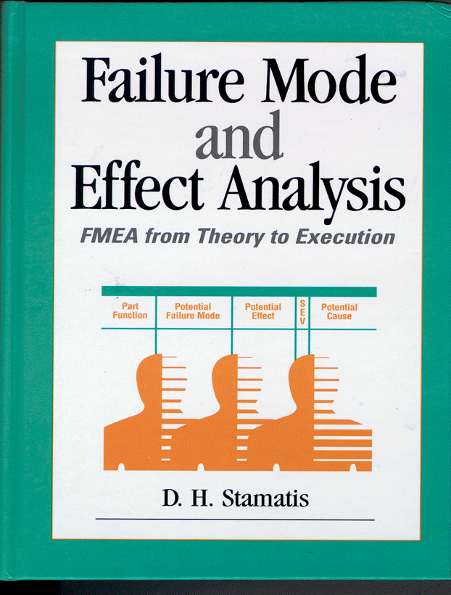
FMEA
Stamatis D.H., Failure Mode and Effect Analysis: FMEA from Theory to Execution
ASQC Quality Press.

Slide 7
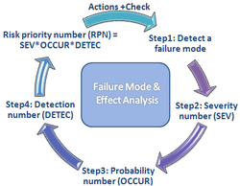
FMEA Outline
What is FMEA?
History
Benefits
Applications
Procedure
Summary
Notes:
These items are the topics that the presentation will cover.

Slide 8
What is FMEA?
FMEA is an acronym that stands for Failure Modes and Effects Analysis
Methodology of FMEA:
To identify ways the product or process can fail and then plan to prevent those failures.
Assess the failures to determine actions that would eliminate the chance of occurrence
Document the potential failures
Notes:
FMEA is a methodology used to:
1. Identify the possible failures that a component can have on a system.
2. Assess how these failures could affect the system.
3. Document the possible failures and the potential effects they could have on the system.

Slide 9
History of FMEA
Created by the aerospace industry in the 1960s.
In 1974 the Navy developed MIL-STD-1629 regarding the use of FMEA.
Ford began using FMEA in 1972.
Incorporated by the “Big Three” in 1988.
Automotive Industry Action Group and American Society for Quality Control copyright standards in 1993.
Notes:
Ford began using FMEA in 1972 to analyze their engineering designs.
Chrysler, Ford, and GM developed QS9000, an automotive equivalent to ISO9000. Design and process FMEAs were a standard for compliance with the QS9000
The AIAG and ASQC presented an FMEA manual that was approved by the Big Three automakers in 1993.

Slide 10

From: “Inviting Disaster – Lessons From the Edge of Technology” By James R. Chiles
Regarding the continuing failure
of rear cargo door on a DC-10:
AA96 - The flight suffered a
cargo door failure on 12 June 1972 while flying over Windsor, Ontario:
“ The design was originally going to use hydraulics, but under pressure from its client, American Airlines, to simplify and lighten the DC-10 equipment; McDonnell Douglas shifted to an electric door closer instead. This worried engineers working for the builder of the door assembly, Convair Division of General Dynamics. Convair engineers even sent McDonnell Douglas a formal document, called a “failure modes effects analysis,” describing the problem and the disastrous consequences.

Slide 11
Types Of FMEA
Project/Program: Identifies what can go wrong with a major project
Design: Identifies what can go wrong with the design of a product or service. Consideration for System, Subsystem, Component.
Process: Identifies what can go wrong with a process
Service: Identifies what can go wrong with a service function
Application: Identifies what can go wrong with customers using your product or service
Notes:
The major difference between a Process FMEA and a Design FMEA (Sometimes Called Product FMEA) is the Design FMEA is concerned about the methods and standards that are used in the design process to prevent failures at the earliest point in the design cycle.
The Process FMEA looks at issues with failures that can be introduced into the product as well as process issues. The process issues may be for the current step or upstream steps. Rework, scrap and sorting are examples of failures in the process.
The Service FMEA is for products and processes that require service. This could be oil changes, tune ups or re-synching databases and pointers. The focus is what can go wrong by performing the service both from intended results and un-intended results.
The application FMEA is a focus of when an end user is using your product or service can they use it in a manner other than designed for and what will the consequences be. Examples are Overloading a device, Using a lawn mower to Trim hedges, using a screw driver as a hammer.

Slide 12
Types Of FMEA
The major difference between a Process FMEA and a Design FMEA (Sometimes Called Product FMEA) is the Design FMEA is concerned about the methods and standards that are used in the design process to prevent failures at the earliest point in the design cycle.
The Process FMEA looks at issues with failures that can be introduced into the product as well as process issues. The process issues may be for the current step or upstream steps. Rework, scrap and sorting are examples of failures in the process.
The Service FMEA is for products and processes that require service. This could be oil changes, tune ups or re-synching databases and pointers. The focus is what can go wrong by performing the service both from intended results and un-intended results
The application FMEA is a focus of when an end user is using your product or service can they use it in a manner other than designed for and what will the consequences be. Examples are Overloading a device, Using a lawn mower to Trim hedges, using a screw driver as a hammer.

Slide 13
Failure is ALWAYS a Design Requirement/Criteria
All Products fail!
Determining how they fail, when they will fail, and why they are failing will allow a designer to incorporate failure as an acceptable design constraint.
Failure as an acceptable design constraint = Customer Satisfaction = Design Quality

Slide 14
When the Design Fails?
Design failure is acceptable if customers perceive it as acceptable.
Design Failure has a direct effect on Customer perception of Product Quality.
Periodic Maintenance (oil changes)
Periodic Replacements (change tyres)
Acceptable End of Life (customer expectations – car replacement every 8-10 years)

Slide 15
Reliability Curve
Assuming a part/product is designed correctly, statistically
it should follow a standard bath-tub curve
Infant Mortality – failures don’t usually affect the customer
Useful life – failures here are problems
Wear Out – failures here are normally acceptable

Slide 16
Causes of Reliability Curve Failure
Early Failure (Infant
Chance Failure
Wear Out Failure
Mortality)
-
-
-
Poor Quality Control
Design Errors
Stress Concentration
-
-
-
Poor workmanship
Insufficient Safety
Corrosion
-
Margins
-
Insufficient Burn In
-
Fatigue
-
Undetected Defects
-
Substandard Materials
-
Creep
-
Mi
sapplication
-
Contamination
-
Abrasive Wear
-
Abuse of Equipment
-
Human Error
-
Wrong Environment
-
Lack of Preventive
-
Incorrect Packaging
Maintenance
Poor Maintenance
-
Acts of God

Slide 17
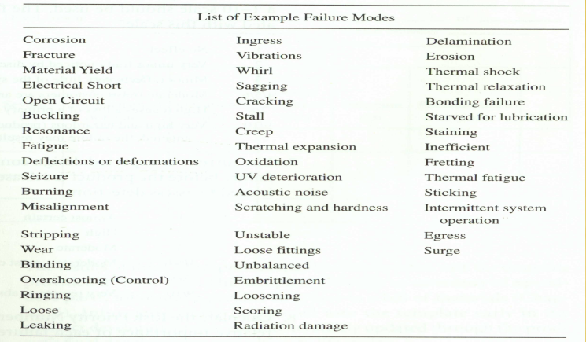
Additional Failure Modes

Slide 18
What are the Benefits?
FMEA is a preventative action
Improvements in
Safety
Quality
Reliability
What other potential benefits can be identified?
Company image
User satisfaction
Lower development costs
Presence of a historical record
Notes:
FMEA is a preventative action. Predefined problems can help with:
Safety- Potential safety problems with a product or service can be defined and rectified before an incident can occur.
Quality- Identifying potential failures and the possible means of fixing these can help reduce quality costs that may have occurred if the problems weren’t identified until implementation of the system.
Reliability- Consumers will be able to rely on a product or service if they do not encounter failures during use.

Slide 19
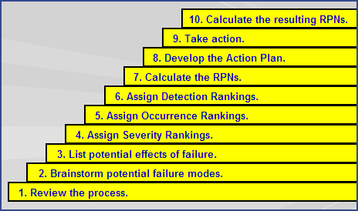
FMEA Steps

Slide 20
Method To Complete FMEA
For each Risk Item, determine the ways in which the Design can go wrong (Failure Modes)
For each Failure Mode associated with the item, determine Effects
Identify potential Causes of each Failure Mode
List the Current Controls for each Cause
Assign Severity, Occurrence and Detection ratings to each Cause
Calculate RPN
Determine Recommended Actions to reduce RPN’s
Take appropriate Actions and Recalculate RPN’s

Slide 21
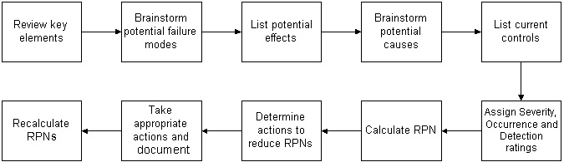
FMEA Steps

Slide 22
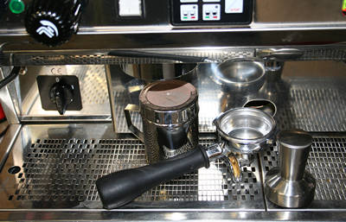

FMEA Example I Coffee Brewing Process
Complete an FMEA for the process below.
Buy
Ingredients
Grind
Beans
Measure
Grounds
Install
Filter
Set Up
Machine
Add Water
Brew Coffee
Serve

Slide 23
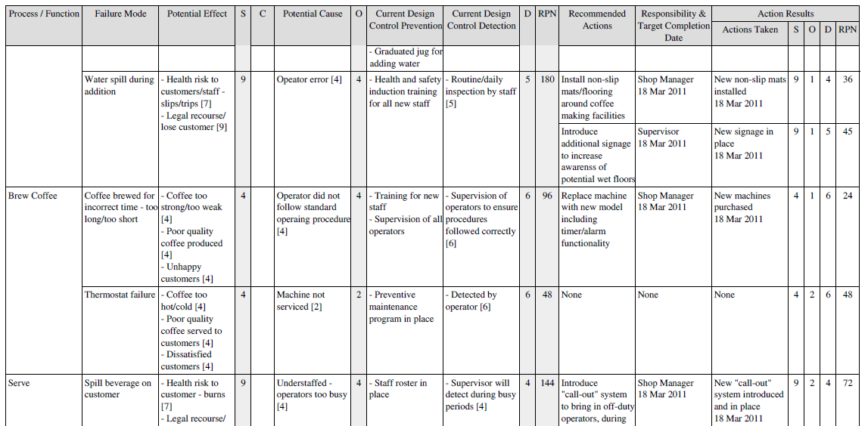
Example II - FMEA Output Coffee Brewing (for Add Water, Brew and Serve Process Steps)
Add Water

Slide 24
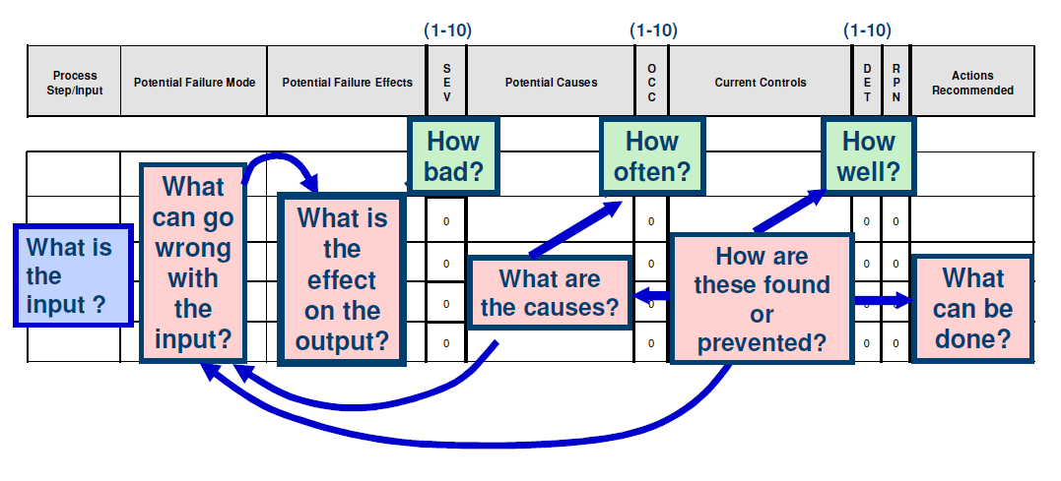
FMEA Form

Slide 25
Blank FMEA Form
1
2
3
4
5
6
System/Component: process being analysed
Design Responsibility: function updating FMEA over time
Prepared By: person currently responsible for FMEA
FMEA Date (Orig): original FMEA release date
(Rev.): date of latest revision of FMEA
Item/Process/Function: specific part of program being analysed and function

Slide 26
Blank FMEA Form
7
9
11
12
8
10
Potential Failure Mode: how component can fail to function
Potential Effects: customer impact of failure mode
Severity (Sev): magnitude of effect of failure mode
Potential Causes: failure point
Occurrence (Occur): rates frequency of failure mode
Detection (Detec): how well can failure be detected

Slide 27
Blank FMEA Form
13
15
16
17
14
Detection (Detec): how well can failure be detected
Risk Priority Number: Severity x Occurrence x Detection; (RPN)
Recommended Actions: actions which will lower RPN rating
Responsibility: individual taking recommended action
Actions Taken: system changes lowering RPN

Slide 28
Risk Priority Numbers, RPN
The risk priority number (RPN) is the product of the rankings for:
Severity (SEV)
Probability of Occurrence (OCC)
Difficulty to Detect (DET)
High RPN’s are flags to take effort to reduce the calculated risk
High severity ratings should be given special attention (regardless of RPN)
RPN = SEV x OCC x DET
Effects
Causes
Controls

Slide 29
Outline of Rating Definitions
Severity | Occurrence | Detection
Hazardous without warning | Very high and almost inevitable | Cannot detect or detection with very low probability
Loss of primary function | High repeated failures | Remote or low chance of detection
Loss of secondary function | Moderate failures | Low detection probability
Minor defect | Occasional failures | Moderate detection probability
No effect | Failure unlikely | Almost certain detection
Rating
High 10
Low 1

Slide 30
When is an FMEA Started?
When new systems, products, and processes are being designed.
When existing designs or processes are being changed.
When carry-over designs/processes will be used in new applications, or new environments.
After completing a Problem Solving Study (to prevent recurrence of problem).

Slide 31
When is an FMEA Started?
For a System FMEA, after System functions are defined, but before specific hardware is selected.
For a Design FMEA, after product functions are defined, but before the design is approved and released to manufacturing.
For a Process FMEA, when preliminary drawings of the product are available.

Slide 32
Getting Started
Utilise Concept Design, Process Maps, Quality Function Deployment, and any other pertinent information
Select people from functions directly upstream and downstream from system under analysis
Engineering
Manufacturing
Quality Assurance
Marketing
Suppliers and other required business functions

Slide 33
Who Prepares an FMEA? Who Updates an FMEA?
A team approach to FMEA's is recommended
The responsible system, product or manufacturing engineer leads the FMEA team
The responsible design or process engineer is expected to involve representatives from all affected activities. Team members should include Design, Manufacturing, Assembly, Quality, Reliability, Service, Purchasing, Testing, Supplier, and other subject matter experts as appropriate.
The responsible System, Product, or Mfg. Engineer is responsible for keeping the FMEA up to date.
Suppliers keep their own FMEA's up to date.

Slide 34
When is a FMEA updated? When is a FMEA completed?
Whenever a change is being considered to a product’s design, application, environment, material, or to a product’s manufacturing or assembly processes.
A Design FMEA is considered completed when the design is released for production.
A Process FMEA is never completed unless the process is removed from the production line.

Slide 35
Failure Modes and Effects Analysis - Advantages
Helps to identify potential product/process failure modes early.
Increased the likelihood that all product/process potential failure modes and their effects will be considered.
Assists in the analysis product/process design requirements and alternatives.

Slide 36
FMEA –Take Homes
Do not try alone, use a group
Time consuming process
Activities are required for completion
Train team
Proper preparation for meetings
Summarise often
Independent voting
Negotiate issues

Slide 37
Next Week
Final MCQ
Covers Entire Course
Test open from 8-11pm only
20 Questions
1 Hour

Slide 38

End of Lecture Course!

